Slide 1







TEAM MEMBERS
EHAB ESSAM
ALAA ALI
ALAA ELSAID
REEM HASSAM
ASMAA AHMED

Slide 2
Fateen is an educational platform designed to connect Egyptian expatriate students in Saudi Arabia and the Gulf with qualified Egyptian tutors. The platform provides online and in-person tutoring services tailored to the Egyptian curriculum ensuring that students maintain academic excellence while staying connected to their cultural heritage.

Slide 3
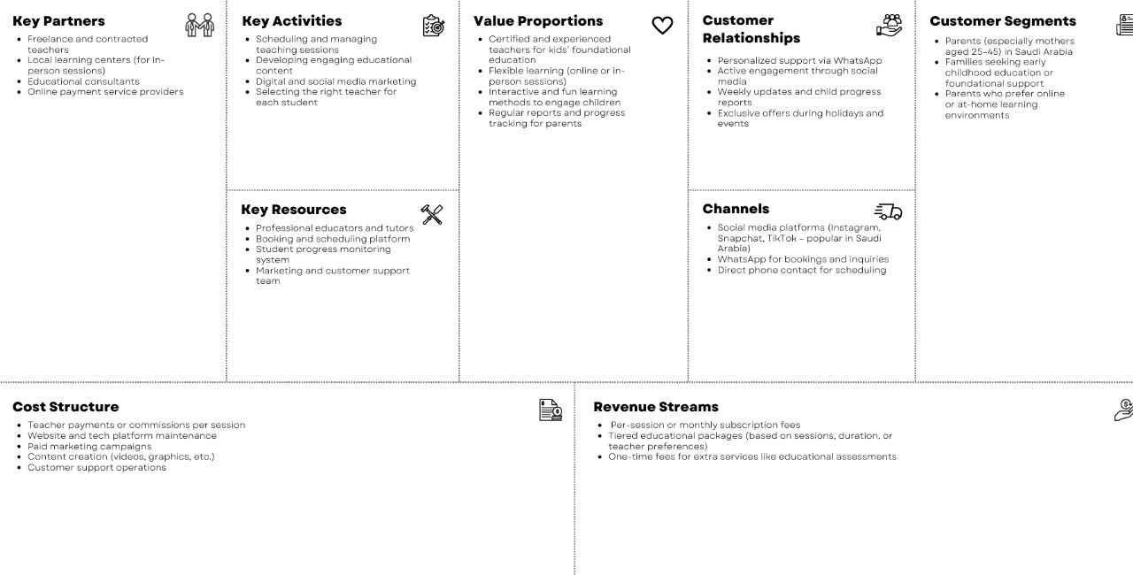

Slide 4





1- Teacher (Layla Ahmed Hassan) Female, 27, based in Cairo Has a Bachelor’s in Education Wants to earn supplemental income and connect with Gulf students Has knowledge in virtual tools and awareness of Gulf dialect/culture | 2- Parent (Mariam Salah Al-Sharkawy) Female, 40, lives in Riyadh Middle to upper income level, family-focused Wants certified Egyptian tutors, flexible schedules, and progress tracking Struggles to find reliable, affordable Egyptian tutoring

Slide 5

INTERNAL ANALYSIS
1
2
3
FINANCIAL MODEL
SERVICES:
TEAM & OPERATIONS
Revenue from subscriptions, per-session payments, and limited advertising.
Major expenses: tutor salaries, platform development, and marketing.
Tutors trained in Zoom, Google Classroom, and other edtech tools.
Admin manages scheduling, recruitment, and quality assurance.
Customer Support respond to parent and student queries
Live tutoring in core subjects (Math, Science, Arabic, etc.).
Exam prep for Egyptian curriculum (primary to secondary).
Certificates and academic progress reports included.

Slide 6
EXTERNAL ANALYSIS
1
2
3
4
COMPETITOR COMPARISON
MARKET INSIGHTS
PEST ANALYSIS
Political: Needs compliance with Saudi and Egyptian education laws.
Economic: Favorable EGP-to-SAR exchange rates help pricing strategy.
Social: Education decisions influenced by family values and heritage.
Tech: Relies on Zoom, MS teams, Kahoot, ...
Saudi Arabia’s EdTech market reached $714.7M in 2023 with a 10% annual growth rate.
Widespread internet and smartphone usage among families.
COVID accelerated demand for digital learning
Madrasati: Government platform, free but limited in customization.
Moalimy: Private tutoring with variable quality.

Slide 7

SWOT ANALYSIS
:
Strengths:
Specialization in the Egyptian curriculum.
Affordable and accessible services.
Strong cultural connection and tech-enabled learning.
Weaknesses:
New brand with limited awareness.
Dependence on third-party platforms (e.g., Zoom).
Scalability and operational bottlenecks.
Opportunities:
Expansion across the Gulf region.
Integration of AI-based assessments.
Collaborations with embassies and cultural institutions.
Threats:
Local and regional competition.
Fluctuating economic conditions.
Increasing data protection regulations

Slide 8

: SMART Objectives
Brand Awareness: Grow social media followers by 50% within 6 months.
User Acquisition: Gain 200 new students through trial sessions in 6 months.
Platform Features: Launch progress dashboard and gamified quizzes in 4 months.
Tutor Base: Onboard 20 vetted Egyptian tutors in 6 months.
Retention Rate: Achieve 70% student retention via loyalty and referral programs

Slide 9

Unique Selling Proposition (USP)
“Fateen bridges cultural and academic gaps for Egyptian expatriates.”
Sole platform offering full Egyptian curriculum alignment.
Tutors share the students’ cultural background.
Pricing optimized through currency advantage (EGP-SAR).
Tech-based learning with gamification and measurable progress

Slide 10
Marketing Mix
Product: Curriculum-aligned tutoring, interactive tools, and progress tracking
Price: Affordable subscriptions and pay-per-session options
Physical Evidence: Digital certificates, parent dashboards, student portfolios
7ps
Place: Delivered through mobile apps, social media, and web
Process: Seamless sign-up, scheduling, and class management.
Promotion: Referral bonuses, testimonials, WhatsApp ads.
People: Verified Egyptian tutors with professional support teams.

Slide 11

challenges and Mitigation
CHALLENGES | MITIGATION
Low brand awareness | Targeted marketing campaigns on social media.
Tutor retention | Offer onboarding support and performance bonuses.
Operational scaling | Invest in automation and scheduling software.
Regulatory issues | Monitor local laws; adopt strong privacy policies.

Slide 12
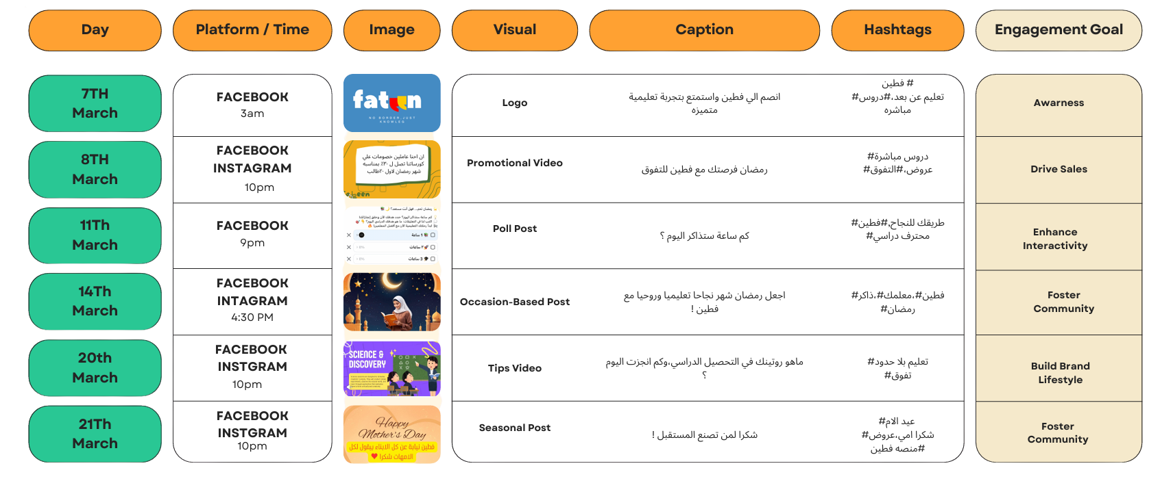


Slide 13

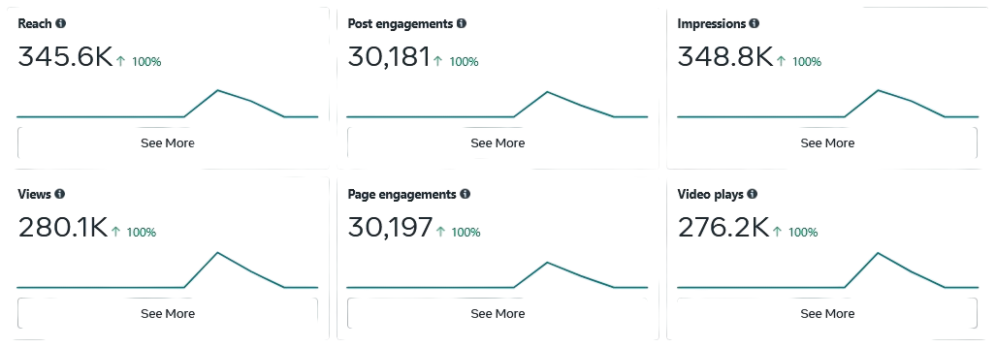
ADS ANALYSIS
https://www.facebook.com/fatin.app1/videos/841933588116647/?notif_id=1743173017911355&notif_t=feedback_reaction_generic&ref=notif

Slide 14




Conclusion & Next Steps
Why Fateen Matters:
Fateen solves a real need for expatriate Egyptian families by providing high-quality, curriculum-aligned, culturally relevant education.
Immediate Priorities:
Execute marketing and tutor onboarding plans.
Launch gamified features and dashboards.
Secure strategic partnerships under Saudi Vision

Slide 15
Fateen Social Media: https://www.facebook.com/fatin.app1 https://www.instagram.com/fatin.app1/ FATIIN.APP@GMAIL.COM

Slide 16
We appreciate your time and consideration. Fateen is our step toward making education more accessible and culturally meaningful.

